Slide 1


Santosh Kumar Kar,
skkar.2k2@gmail.com

Slide 2
CHAPTER – 11
Spring Security
Santosh Kumar Kar
skkar.2k2@gmail.com

Slide 3
Spring Security
a Java/Java EE framework
Provides
Authentication - who are you?
Authorization (aka access control) - what are you allowed to do?
designed to separate authentication from authorization

Slide 4
Interface AuthenticationManager
The main strategy interface for authentication is AuthenticationManager which only has one method:
public interface AuthenticationManager {
Authentication authenticate(Authentication authentication) throws AuthenticationException;
}

Slide 5
An AuthenticationManager can
Return an Authentication (normally with authenticated=true)
if it can verify that the input represents a valid principal.
OR
Throw an AuthenticationException
if it believes that the input represents an invalid principal.
OR
Return null
if it can’t decide.

Slide 6
interface AuthenticationProvider
The most commonly used implementation of AuthenticationManager is
ProviderManager
Delegates to a chain of AuthenticationProvider instances
An AuthenticationProvider is a bit like an AuthenticationManager
public interface AuthenticationProvider {
Authentication authenticate(Authentication authentication)
throws AuthenticationException;
boolean supports(Class<?> authentication);
}

Slide 7
Customizing Authentication Managers
The most commonly used helper is the AuthenticationManagerBuilder
great for setting up in-memory, JDBC or LDAP user details
or good for adding a custom UserDetailsService
@Configuration
public class ApplicationSecurity extends WebSecurityConfigurerAdapter {
... // web stuff here
@Autowired
public void configure(AuthenticationManagerBuilder builder) { builder.jdbcAuthentication().dataSource(dataSource)
.withUser("santosh").password("letmein").roles("USER");
}
}

Slide 8
Web Security
is based on Servlet Filters
The client sends a request to the app
The container decides which filters and which servlet apply to it based on the path of the request URI.

Slide 9
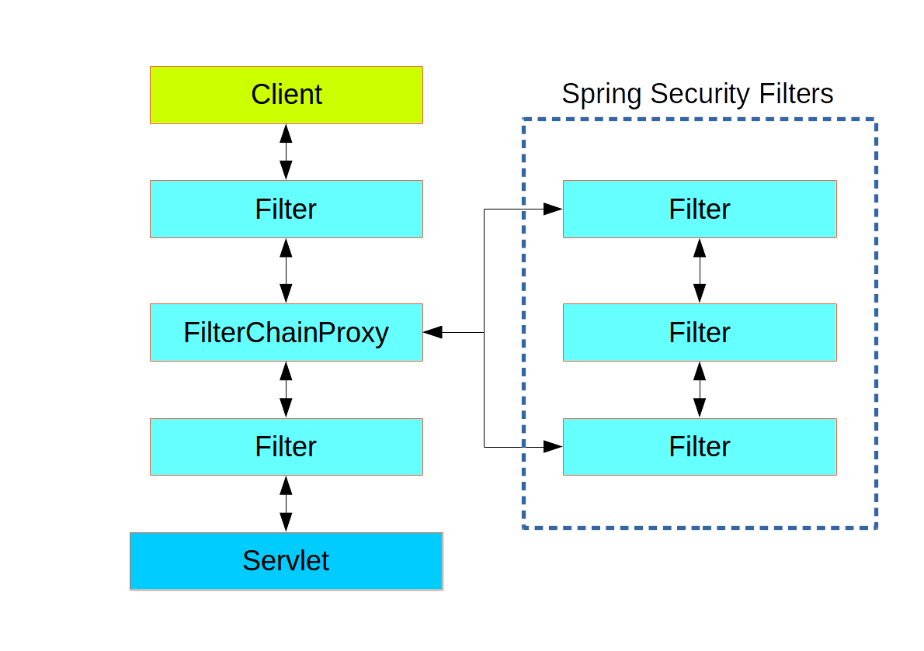
Security Filters

Slide 10
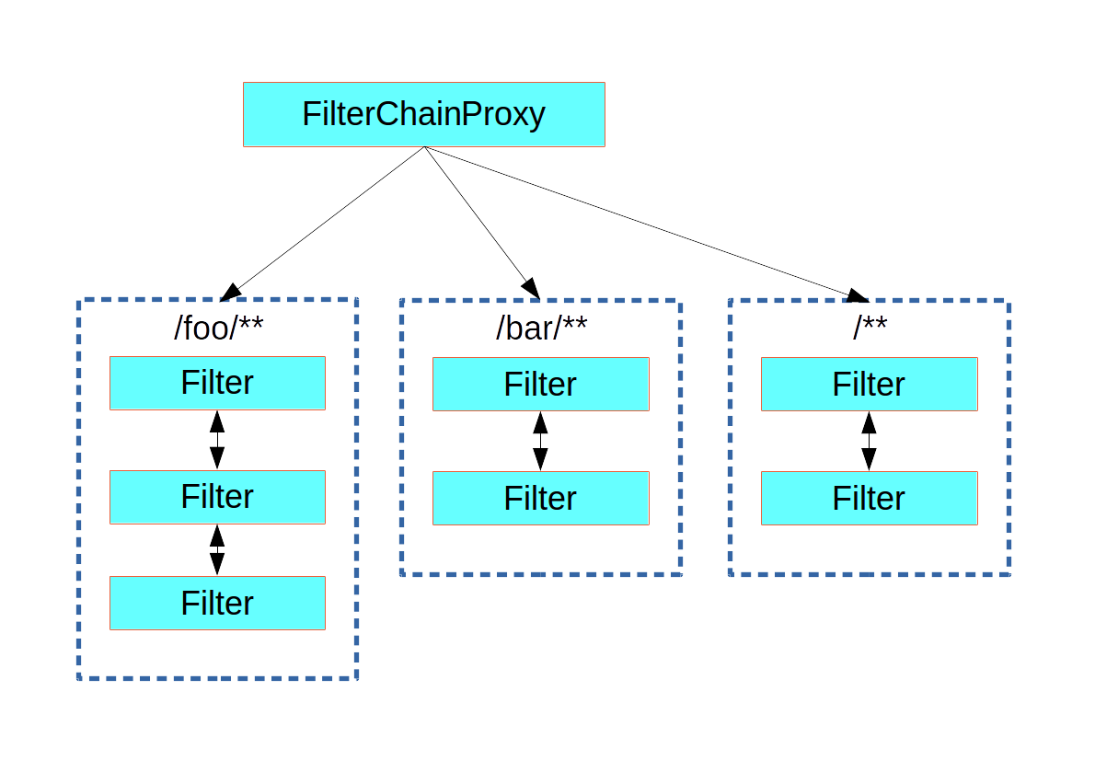
FilterChainProxy dispatches requests to the first chain that matches.

Slide 11
Customizing Filter Chains
@Configuration
public class ApplicationConfigurerAdapter
extends WebSecurityConfigurerAdapter {
@Override protected void configure(
HttpSecurity http) throws Exception {
http.antMatcher("/foo/**") ...;
}
}

Slide 12
Request Matching for Dispatch and Authorization
A security filter chain (or equivalently a WebSecurityConfigurerAdapter) has a request matcher that is used for deciding whether to apply it to an HTTP request
@Configuration public class ApplicationConfigurerAdapter
extends WebSecurityConfigurerAdapter {
@Override
protected void configure(HttpSecurity http)
throws Exception {
http.antMatcher("/foo/**") .authorizeRequests()
.antMatchers("/foo/bar").hasRole("BAR")
.antMatchers("/foo/spam").hasRole("SPAM")
.anyRequest()
.isAuthenticated();
}
}

Slide 13
Method Security
Spring Security offers support for applying access rules to Java method executions
To enable method security
@SpringBootApplication
@EnableGlobalMethodSecurity(securedEnabled = true)
public class SampleSecureApplication{
}
decorate the method
@Service public class MyService { @Secured("ROLE_USER")
public String secure() {
return "Hello Security";
}
}

Slide 14
Access to the currently authenticated user in a web endpoint
Use a method parameter in a @RequestMapping
@RequestMapping("/foo")
public String foo(@AuthenticationPrincipal User user) {
... // do stuff with user
}
@RequestMapping("/foo")
public String foo(Principal principal) {
Authentication authentication = (Authentication) principal;
User = (User) authentication.getPrincipal();
... // do stuff with user
}

Slide 15
An example of flow
Browser submits authentication credentials (user name, password)
AuthenticationManager collects all the details
AuthenticationRequest object is build
AuthenticationRequest is sent to an AuthenticationManager
AuthenticationManager is responsible for passing the request through a chain of AuthenticationProvider
AutheincationProvider will ask UserDetailsService to provide a UserDetails object
The UserDetails object contains the array of GrantedAuthority, will be used to build the fully populated Authentication object

